Slide 1

DP-200T01: Orchestrating Data Movement with Azure Data Factory
Notes:
Instructor notes
This space has been left deliberately blank.

Slide 2
Agenda
L01 - Introduction to Azure Data Factory
L02 - Understand Azure Data Factory components
L03 - Integrate Azure Data Factory with Databricks
Notes:
Instructor notes
This space has been left deliberately blank.

Slide 3



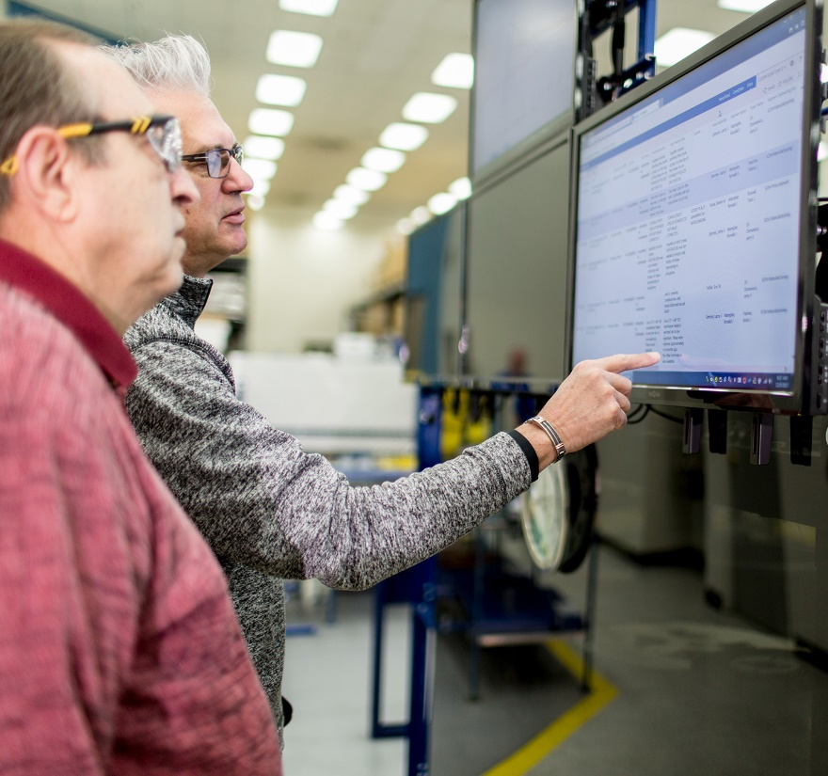






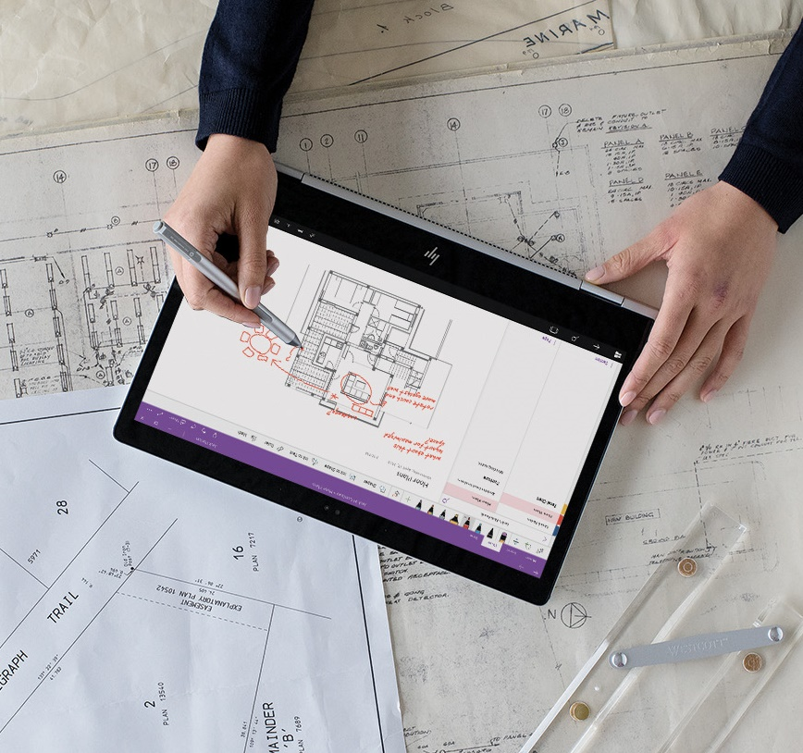


Lesson 01
Introduction to
Azure Data Factory
Notes:
Instructor notes
This space has been left deliberately blank.

Slide 4
Lesson Objectives
What is Azure Data Factory
The Data Factory process
Azure Data Factory components
Azure Data Factory security
Notes:
Instructor notes
Ensure that all of your students fully understand the components and processes involved. This will be the focus of the module.

Slide 5


What is Azure Data Factory
Creates, orchestrates, and automates the movement, transformation and/or analysis of data through in the cloud.
Notes:
Instructor notes
The words in this statement is precise.
“Creates” – Azure Data Factory (ADF) can natively create data movement and transformation operations
“orchestrates” – ADF can call on other technologies to perform data movement and transformation operations.
“automates” – ADF can schedule or trigger the data movement and transformation operations that are created.
“transformation” – ADF has the capability to perform data transformations, call other technologies to perform transformations, or run SSIS packages.
“analysis” – ADF calls other technologies to perform analysis of data.
“transformation and/or analysis ” -

Slide 6
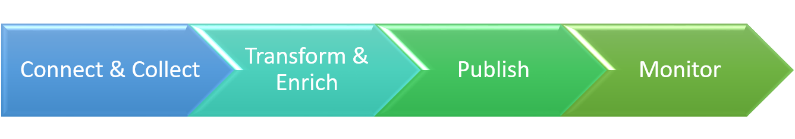
The Data Factory Process
Notes:
Instructor notes
You will notice that this process is slightly different from the process in Big Data Analytics, but essentially it does similar process
Connect & Collect: This is where you connect to a data source and ingest (collect) data into ADF pipelines.
Transform & Enrich: This is where you use ADF, SSIS packages, or other technologies called by ADF to transform and augment data.
Publish: ADF places the transformed data in a data store or a compute resource.
Monitor: As with technologies that involve the movement and processing of data, errors can occur. Monitoring is an important part of the solution.

Slide 7
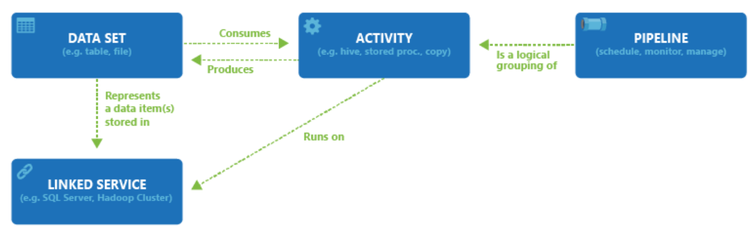
Azure Data Factory Components
Multiple activities can be logically grouped together with an object referred to as a Pipeline
Datasets represent data structures within the data store that is being referenced by the Linked Service object.
Activities typically contain the transformation logic or the analysis commands of the Azure Data Factory’s work.
Control Flow
Parameters
Integration runtime
Linked Services enables you to define data sources, or compute resource that are required to ingest and prepare data
Notes:
Instructor notes
Read more about the ADF Components and dependency between them here:
https://docs.microsoft.com/en-gb/azure/data-factory/data-factory-introduction#relationship-between-data-factory-entities

Slide 8
Azure Data Factory
Security
Data Factory Contributor Role
Create, edit, and delete data factories and child resources including datasets, linked services, pipelines, triggers, and integration runtimes.
Deploy Resource Manager templates. Resource Manager deployment is the deployment method used by Data Factory in the Azure portal.
Manage App Insights alerts for a data factory.
At the resource group level or above, lets users deploy Resource Manager template.
Create support tickets.
Notes:
Instructor notes
Full information on the roles that can be used in ADF can be read at the following link:
https://docs.microsoft.com/en-gb/azure/data-factory/concepts-roles-permissions

Slide 9
Lesson 02
Azure Data Factory
Components
Notes:
Instructor notes
This space has been left deliberately blank.

Slide 10
Lesson Objectives
Linked Services
Datasets
Data Factory activities
Pipelines
Pipeline example
Notes:
Instructor notes
This lesson will go through objects of ADF in more depth. These objects can be created through a graphical user interface, or programmatically through JSON notation.
Slide 13 is a build slide that enable you to step though and talk about each object.
Slide 14 – 16 show the JSON notation to use when creating the objects programmatically.

Slide 11



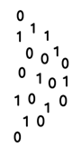




Azure Data Factory components
@
Triggers
Parameters
Linked Service
IR
Integration
Runtime
CF
Control
Flow
Pipeline
Data Lake Store
1
Activities
Azure Databricks
Dataset
Notes:
Instructor notes
This is a build slide that enables you to talk in depth about each object. Below is a summary of the clicks, to indicate what you can talk about at each click:
Click 1 – Enable you to speak about Linked Services:
Click 2 – Use Data Lake Store as a storage resource example
Click 3 – Use Databricks as a compute resource example
Click 4 – Enables you to talk about the Dataset object
Click 5 – this is a graphic to show a flow of data
Click 6 – Bring up the word activity
Click 7 – shows a rotating cog to reflect a single activity
Click 8 – removes the word activity
Click 9 - shows multiple rotating cogs to reflect multiple activities
Click 10 – Shows a funnel with the word pipeline to show that activities are grouped into a pipeline.
Click 11 – The word trigger appears with a circular arrow
Click 12 – The circular arrow rotates to indicate that a pipeline is triggered to execute
Click 13 - nothing happens
Click 14 – a number 1 appears out of the data and flows through the pipeline into the data set to reflect data being transformed by the activities in a pipeline
Click 15 - The word Parameters with an @ symbol appears
Click 16 – The word Integration runtime appears with an IR icon
Click 17 - The word Control Flow appears with the CF icon

Slide 12
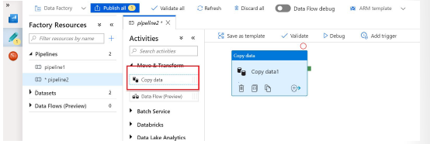
Creating Linked Services
Linked services are much like connection strings
Over 80 connectors available.
A linked service in Data Factory is defined using the Copy Data Activity in the ADF designer
Notes:
Instructor notes
This lesson will go through objects of ADF in more depth. These objects can be created through a graphical user interface, or programmatically through JSON notation.
Slide 13 is a build slide that enable you to step though and talk about each object.
Slide 14 – 16 show the JSON notation to use when creating the objects programmatically.

Slide 13
Linked Services
AZURE SQL DATABASE EXAMPLE
{
"name": "AzureSqlLinkedService",
"properties": {
"type": "AzureSqlDatabase",
"typeProperties": {
"connectionString": "Server=tcp:ctosqldb.database.windows.net,1433;Database=EquityDB;User ID=ctesta-oneill;Password=P@ssw0rd;Trusted_Connection=False;Encrypt=True;Connection Timeout=30"
}
}
}
AZURE BLOB STORE EXAMPLE
{
"name": "StorageLinkedService",
"properties": {
"type": "AzureStorage",
"typeProperties": {
"connectionString": "DefaultEndpointsProtocol=https;AccountName=ctostorageaccount;AccountKey=087ubp097guhB*(97g9879"
}
}
}
Notes:
Instructor notes
This is a build slide that enables you to show an example of defining linked services using JSON, showing an example of Azure SQL Database and Azure Blob store. More information can be found at:
https://docs.microsoft.com/en-us/azure/data-factory/data-factory-introduction#linked-services

Slide 14
Datasets
{
"name": "<name of dataset>",
Dataset name
"properties": {
Properties
"type": "<type of dataset: AzureBlob, AzureSql etc...>",
"external": <boolean flag to indicate external data. only for input datasets>,
"linkedServiceName": "<Name of the linked service that refers to a data store.>",
Type
"structure": [
{
"name": "<Name of the column>",
"type": "<Name of the type>"
}
],
"typeProperties": {
"<type specific property>": "<value>",
"<type specific property 2>": "<value 2>",
},
AzureSqlLinkedService
External
StorageLinkedService
LinkedServiceName
Structure
Name
"availability": {
"frequency": "<Specifies the time unit for data slice production. >",
"interval": "<Specifies the interval within the defined frequency.>"
},
Type
Availability
"policy":
{
}
}
}
Policy
Notes:
Instructor notes
This is a build slide that enables you to show an example of defining datasets using JSON. More information can be found at:
https://docs.microsoft.com/en-us/azure/data-factory/data-factory-create-datasets

Slide 15
Data Factory Activities
Activities within Azure Data Factory defines the actions that will be performed on the data and there are three categories including:
Data movement activities
Data movement activities simply move data from one data store to another. A common example of this is in using the Copy Activity.
Data transformation activities
Data transformation activities use compute resource to change or enhance data through transformation, or it can call a compute resource to perform an analysis of the data.
Control Activities
Control flow orchestrate pipeline activities that includes chaining activities in a sequence, branching, defining parameters at the pipeline level, and passing arguments while invoking the pipeline on-demand or from a trigger
Notes:
Instructor notes
These links are in the student materials to get the latest information on the actions that can be performed in ADF as this is constantly being updated:
Data movement activities
https://docs.microsoft.com/en-us/azure/data-factory/concepts-pipelines-activities#data-movement-activities
Data transformation activities
https://docs.microsoft.com/en-us/azure/data-factory/concepts-pipelines-activities#data-transformation-activities
Control activities
https://docs.microsoft.com/en-us/azure/data-factory/concepts-pipelines-activities#control-activities

Slide 16
Control activities
Execute Pipeline Activity
ForEachActivity
WebActivity
Lookup Activity
Get Metadata Activity
Until Activity
If Condition Activity
Wait Activity
Notes:
Instructor notes
This lesson will go through objects of ADF in more depth. These objects can be created through a graphical user interface, or programmatically through JSON notation.
Slide 13 is a build slide that enable you to step though and talk about each object.
Slide 14 – 16 show the JSON notation to use when creating the objects programmatically.

Slide 17
Pipelines
Pipeline is a grouping of logically related activities.
Pipeline can be scheduled so the activities within it get executed.
Pipeline can be managed and monitored.
Notes:
Instructor notes
Use this slide to remind students about pipelines before going into the next slide to show JSON notation
https://docs.microsoft.com/en-gb/azure/data-factory/data-factory-create-pipelines

Slide 18
Integration runtime
In Data Factory, an activity defines the action to be performed.
A linked service defines a target data store or a compute service.
An integration runtime provides the bridge between the activity and linked services.
It is referenced by the linked service or activity and provides the compute environment where the activity either runs on or gets dispatched from.
Activity can be performed in the region closest possible to the target data store or compute service
Notes:
Instructor notes
This lesson will go through objects of ADF in more depth. These objects can be created through a graphical user interface, or programmatically through JSON notation.
Slide 13 is a build slide that enable you to step though and talk about each object.
Slide 14 – 16 show the JSON notation to use when creating the objects programmatically.

Slide 19
Azure integration runtime
Running Data Flows in Azure
Running copy activity between cloud data stores
Dispatching the following transform activities in public network:
Databricks Notebook/ Jar/ Python activity, HDInsight Hive activity, etc.
Notes:
Instructor notes
This lesson will go through objects of ADF in more depth. These objects can be created through a graphical user interface, or programmatically through JSON notation.
Slide 13 is a build slide that enable you to step though and talk about each object.
Slide 14 – 16 show the JSON notation to use when creating the objects programmatically.

Slide 20
Self-hosted integration runtime
Running copy activity between a cloud data stores and a data store in private network.
Dispatching transform activities against compute resources in on-premises or Azure Virtual Network
The self-hosted IR is logically registered to the Data Factory and the compute used to support its functionalities is provided by you.
Notes:
Instructor notes
This lesson will go through objects of ADF in more depth. These objects can be created through a graphical user interface, or programmatically through JSON notation.
Slide 13 is a build slide that enable you to step though and talk about each object.
Slide 14 – 16 show the JSON notation to use when creating the objects programmatically.

Slide 21
Azure-SSIS Integration Runtime
To lift and shift existing SSIS workload, you can create an Azure-SSIS IR to natively execute SSIS packages.
Selecting the right location for your Azure-SSIS IR is essential to achieve high performance in your ETL workflows.
The location of your Azure-SSIS IR does not need be the same as the location of your data factory, but it should be the same as the location of your own Azure SQL Database/Managed Instance server where SSISDB is to be hosted.
Notes:
Instructor notes
This lesson will go through objects of ADF in more depth. These objects can be created through a graphical user interface, or programmatically through JSON notation.
Slide 13 is a build slide that enable you to step though and talk about each object.
Slide 14 – 16 show the JSON notation to use when creating the objects programmatically.

Slide 22
Lesson 03
Ingesting and Transforming
data
Notes:
Instructor notes
This space has been left deliberately blank.

Slide 23
Lesson Objectives
How to setup Azure Data Factory
Ingest data using the Copy Activity
Transforming data with the Mapping Data Flow
Notes:
Instructor notes
In this lesson, the focus is on how you can perform code free ingestion and transformations within Azure Data Factory.

Slide 24
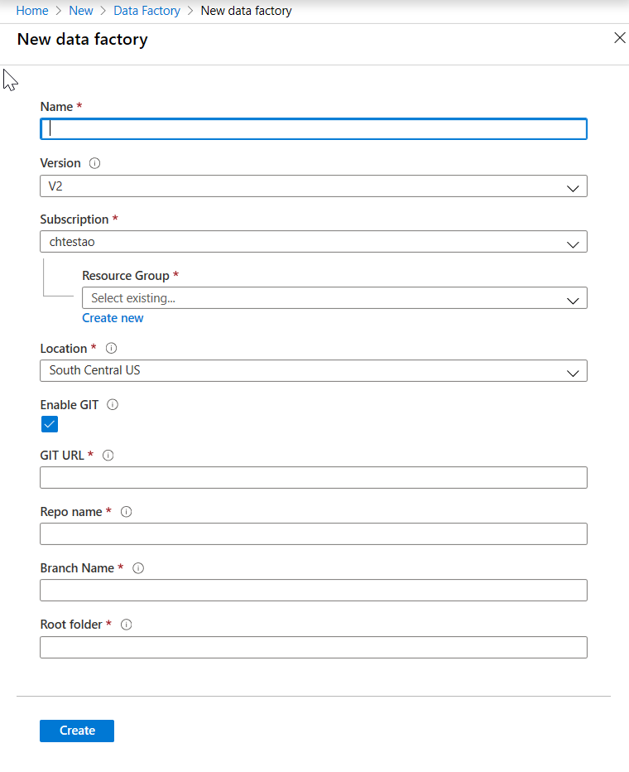
Create Azure Data Factory
Notes:
Instructor notes
You can either use this screenshot to go through the settings for Azure Data Factory, alternatively, log into the Azure portal to see the latest GUI version. Use this to drive the conversation around the Azure Data Factory settings.

Slide 25

Ingesting data with the Copy Activity
Reads data from a source data store.
Performs serialization/deserialization, compression/decompression, column mapping, and so on. It performs these operations based on the configuration of the input dataset, output dataset, and Copy activity.
Writes data to the sink/destination data store
Notes:
Instructor notes
The Copy activity performs the following steps:
Reads data from a source data store.
Performs serialization/deserialization, compression/decompression, column mapping, and so on. It performs these operations based on the configuration of the input dataset, output dataset, and Copy activity.
Writes data to the sink/destination data store

Slide 26
Transforming data with the Mapping Data Flow
Code free data transformation at scale
Perform data cleansing, transformation, aggregations, etc.
Enables you to build resilient data flows in a code free environment
Enable you to focus on building business logic and data transformation
Underlying infrastructure is provisioned automatically with cloud scale via Spark execution
Mapping Data Flow
Notes:
Instructor notes
Review the information in the following link for an overview of the Mapping Data Flow.
https://docs.microsoft.com/en-us/azure/data-factory/concepts-data-flow-overview
There is additional information in this area in the documentation

Slide 27
Lesson 04
Integrate Azure Data Factory
with Azure Databricks
Notes:
Instructor notes
This space has been left deliberately blank.

Slide 28
Lesson Objectives
Use Azure Data Factory (ADF) to ingest data and create an ADF pipeline.
Create Azure Storage account and the Azure Data Factory instance
Use ADF to orchestrate data transformations using a Databricks Notebook activity.
Notes:
Instructor notes
In this lesson, we are showing to students how ADF can be used to call compute resources to perform data transformations. Azure Databricks is being used as an example in this course.

Slide 29

Working with documents programmatically
1.
Create Storage
Account
2.
Create Azure
Data Factory
3.
Create data
workflow
pipeline
4.
Add Databricks
Workbook to
pipeline
5.
Perform analysis
on the data
Notes:
Instructor notes
The students should already be familiar with the first three steps pf creating a storage account, creating Azure Data Factory, and creating a data workflow activity using a Copy Activity.
Focus on steps 4 and 5 which are focused in Azure Databricks

Slide 30
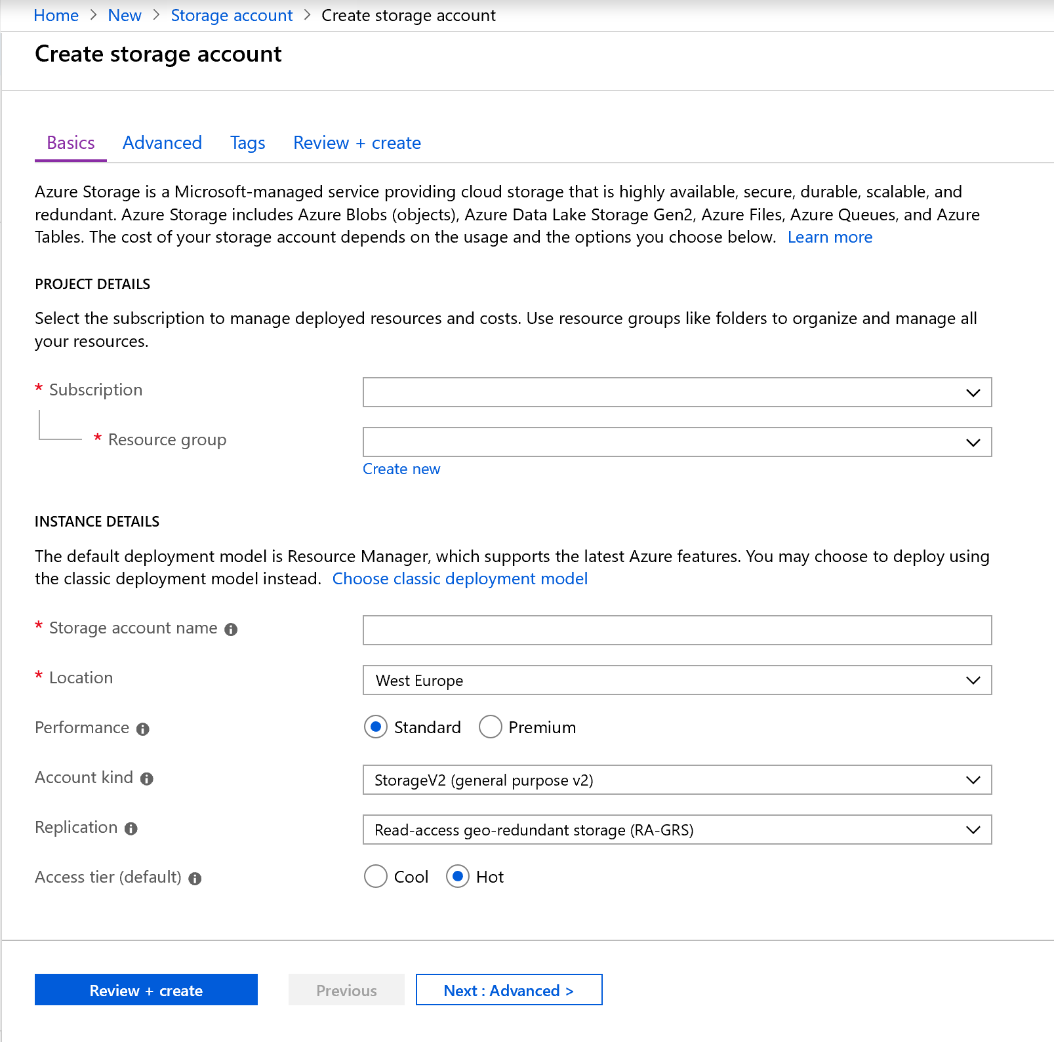
Create Azure Storage account and the Azure Data Factory Instance
Notes:
Instructor notes
The students should be familiar with this already

Slide 31
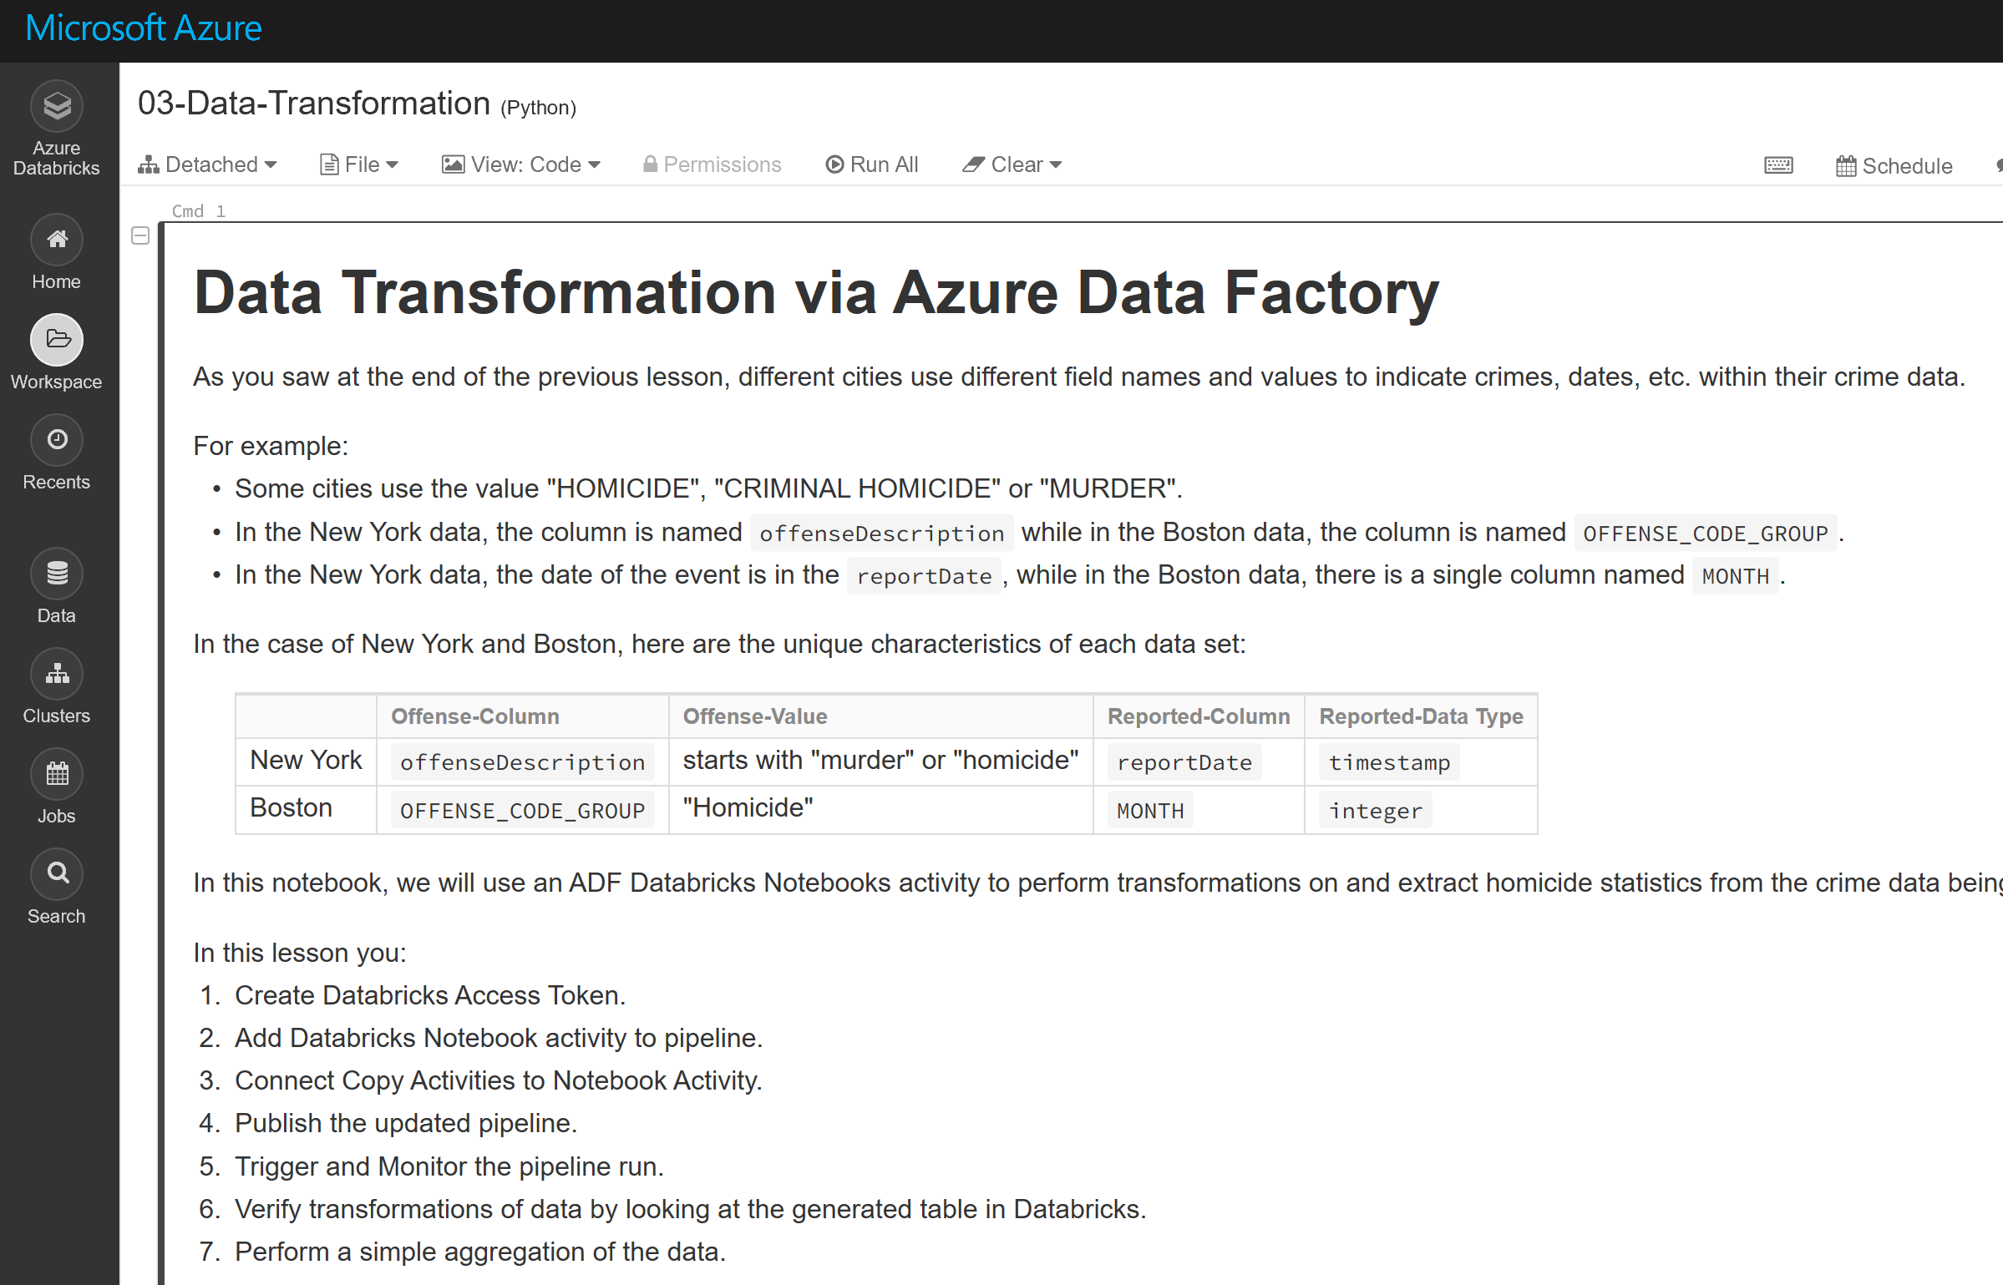
Use ADF to orchestrate data transformations using a Databricks Notebook activity
Notes:
Instructor notes
You can either use this screenshot to go through the data transformations for Azure Data Factory and Azure Databricks, alternatively, log into the Azure portal to see the latest GUI version.

Slide 32
Understanding Pricing
https://www.slideshare.net/CathrineWilhelmsen/lessons-learned-understanding-azure-data-factory-pricing-microsoft-ignite-2019
https://docs.microsoft.com/en-us/azure/data-factory/pricing-concepts
Notes:
Instructor notes
This lesson will go through objects of ADF in more depth. These objects can be created through a graphical user interface, or programmatically through JSON notation.
Slide 13 is a build slide that enable you to step though and talk about each object.
Slide 14 – 16 show the JSON notation to use when creating the objects programmatically.

Slide 33

Lab: Orchestrating Data Movement with Azure Data Factory
Notes:
Instructor notes
This space has been left deliberately blank.

Slide 34
Lab overview
In this module, students will learn how Azure Data factory can be used to orchestrate the data movement from a wide range of data platform technologies. They will be able to explain the capabilities of the technology and be able to set up an end to end data pipeline that ingests data from SQL Database and load the data into SQL Data Warehouse. The student will also demonstrate how to call a compute resource.
Lab objectives
After completing this lab, you will be able to:
Explain how Azure Data Factory works
Azure Data Factory Components
Notes:
Instructor notes
This space has been left deliberately blank.

Slide 35
Lab overview
Exercise 1: Setup Azure Data Factory
Exercise 2: Ingest data using the Copy Activity
Exercise 3: Transforming Data with Mapping Data Flow
Exercise 3 -Task 4 - Writing to a Data Sink
No usar Synapse Analytics como dice en GitHub.
Usar el SQL Database que les voy a Pasar
Notes:
Instructor notes
This space has been left deliberately blank.

Slide 36
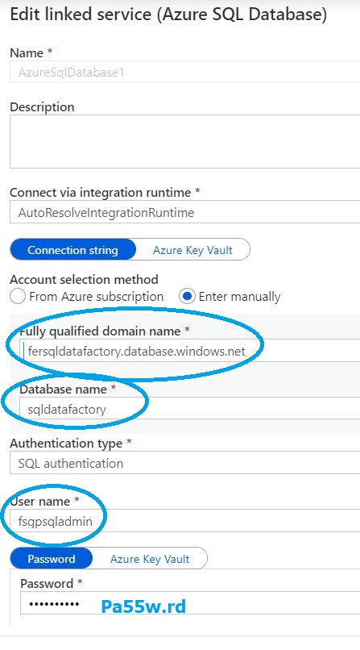
SQL Database Sink

Slide 37
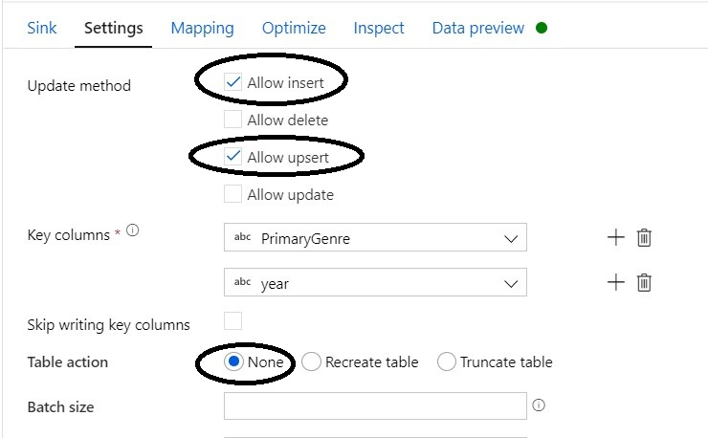
Dataflow Settings

Slide 38
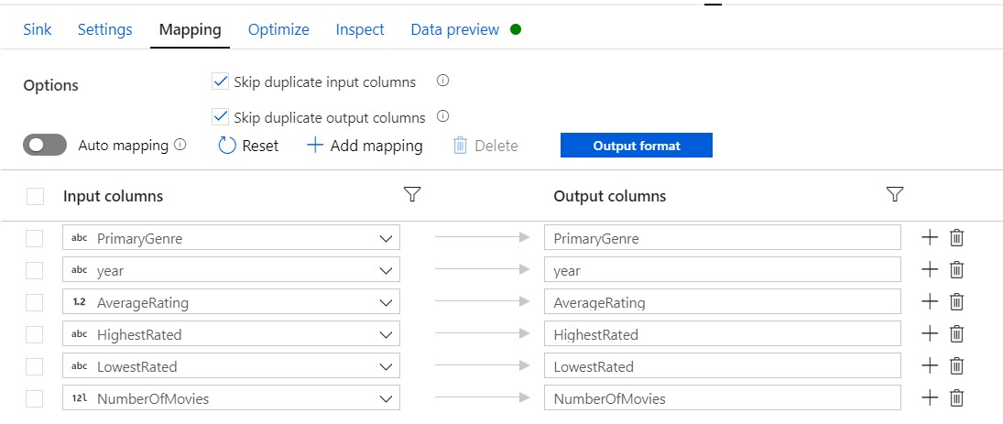
Dataflow Mapping

Slide 39
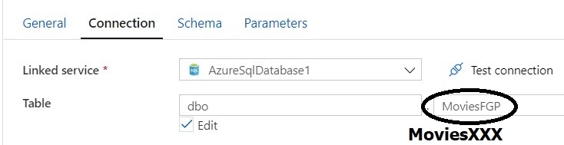
Table Name

Slide 40
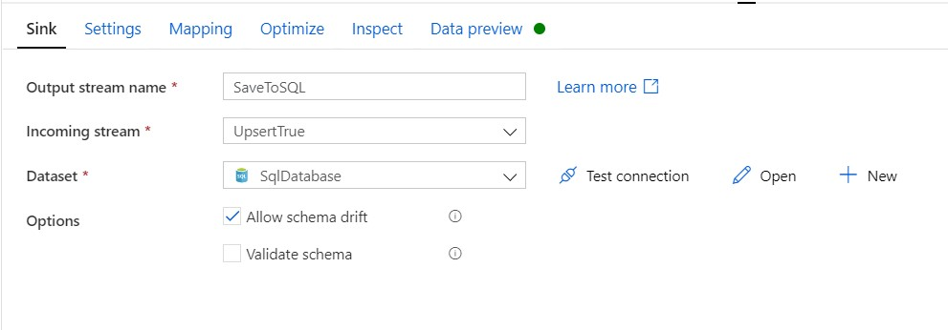
Sink

Slide 41
Lab review
Q01 - Can you think of example of automating batch data loads with Azure Data Factory back at work?
Notes:
Instructor notes
These questions are deliberately open-ended to promote a discussion between the students to reinforce learning

Slide 42

Next steps
Module Summary
In this module, you have learned about:
- Learned Azure Data Factory
- Understood Azure Data Factory Components
- Integrate Azure Data Factory with Databricks
After the course, read the white paper on data migration from on-premise relational data warehouse to Azure using Azure Data Factory
Notes:
Instructor notes
The next steps is suggested post course learning materials to reinforce what they have learned in the module.

Slide 43
Notes:
Instructor notes
This space has been left deliberately blank.

